Slide 1
REACTIVE POWER MANAGMENT
Krishna Rao 11B81A02A9
Sridhar Reddy 11B81A0289
Avinash Choudary 11B81A02A7

Slide 2
Introduction
Indian distribution system- losses
VAR compensation- the management of reactive power to improve the performance of ac power systems.
Most of power quality problems can be attenuated or solved with an adequate control of reactive power.
The problem of reactive power compensation are
load compensation and voltage support
Load compensation- increase the power factor, to balance the real power, compensate voltage regulation and to eliminate current harmonic components produced by large and fluctuating nonlinear industrial loads

Slide 3
Voltage support- to reduce voltage fluctuation at a given terminal of a transmission line
Reactive power compensation in transmission systems also improves the stability
Maintain voltage profile at all levels of power transmission, it improves HVDC conversion terminal performance, efficiency, controls steady-state and temporary overvoltage’s and avoid disastrous blackouts
Series and shunt VAR compensation are used
This project presents an overview of the static VAR technologies. Static compensators implemented with thyristors and self-commutated converters are described.

Slide 4
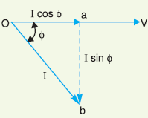
Power factor
The electric energy is almost exclusively generated, transmitted in the form of alternating current. Most of the loads are inductive in nature and hence have low power factor
The low power factor highly undesirable -increase in current, resulting in additional losses of active power in all the elements in power systems from power station generator down to utilization devices
The cosine of angle between voltage
and current in an a.c. circuit is
known as power factor.

Slide 5
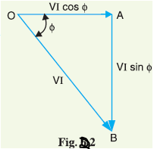
OA= VIcosØ and represents the active power in watts or kW. AB=VIsinØ and represents the reactive power in VAR or kVAR. OB=VI represents the apparent power in VA or KVA
Disadvantages
Large kVA rating of equipmentGreater conductor size
Large copper losses
Poor voltage regulation
Causes of low power factor
Induction type
Arc lamps
Magnetization current

Slide 6
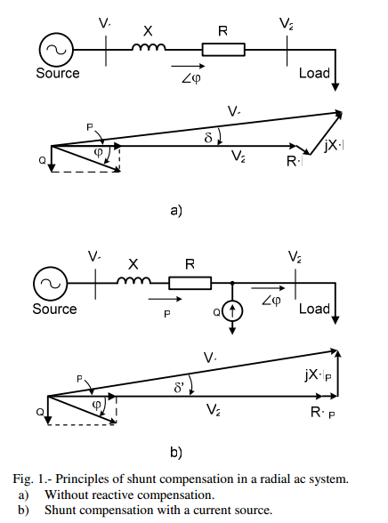
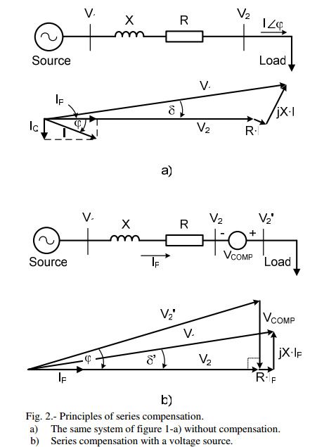
REACTIVE POWER COMPENSATION PRINCIPLES
Shunt Compensation
Series Compensation

Slide 7
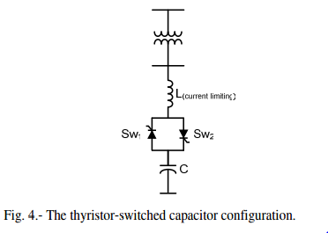
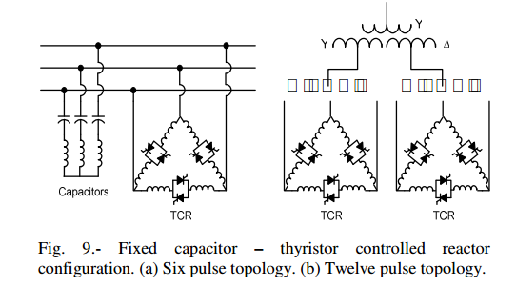
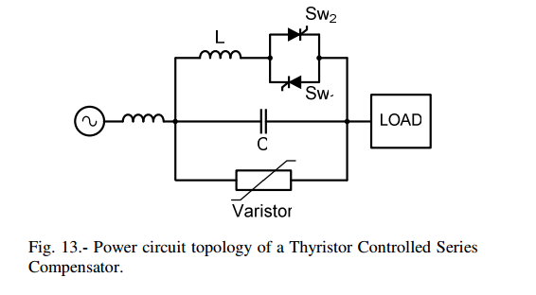
TRADITIONAL VAR GENERATORS
Fixed or mechanically switched capacitors
Synchronous Condensers
Thyristorized VAR Compensators
Thyristor-Switched Capacitors
Thyristor-Controlled Reactor
Thyristor Controlled Series Compensation

Slide 8
SELF-COMMUTATED VAR COMPENSATORS
Principles of Operation
Multi-Level Compensators
Three-Level Compensators
Semiconductor Devices used for Self-Commutated VAR Compensators
Comparison Between Thyristorized and Self- commutated Compensators

Slide 9
NEW VAR COMPENSATOR´S TECHNOLOGY
Static Synchronous Compensator (STATCOM).
Static Synchronous Series Compensator (SSSC).
Dynamic Voltage Restorer (DVR)
Unified Power Flow Controller (UPFC).
Interline Power Flow Controller (IPFC)
Superconducting Magnetic Energy Storage (SMES)

Slide 10
VARCOMPENSATOR´SAPPLICATIONS
Wind and Railways
Steady-state and dynamic voltage stabilization
Continuous power factor control
Cooling system
Stabilized voltages in weak systems
Reduced transmission losses
Increased transmission capacity, to reduce, defer or
Eliminate the need for new lines
Higher transient stability limit
Greater voltage control and stability
Power oscillation damping

Slide 11
THANK YOU

